Slide 1
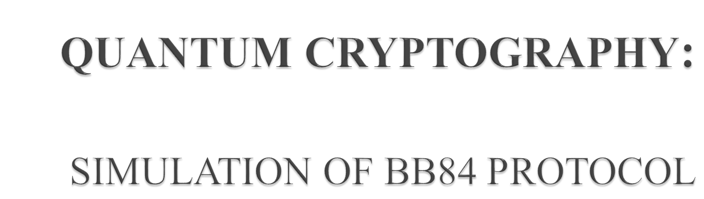
RAJ KUMAR (BE/1245/2011)
ASHUTOSH KUMAR (BE/1212/2011)
ARNAVESH VARUN GIRI (BE/1388/2011)
GUIDE:
DR. R. SUKESH KUMAR

Slide 2
OBJECTIVE
PROBLEM STATEMENT :
Study of Quantum Cryptography and subsequent simulation of BB84 Protocol used for secret key sharing.
OUR APPROACH :
An algorithm for BB84 Protocol was designed with detailed flow chart (will be discussed)
Based on the algorithm a simulation model was designed and then implemented in C language (The output screenshots will be shown)

Slide 3

What is Cryptography?
Cryptography is the art of devising codes and ciphers.
Crypto analysis is the art of breaking them.
Cryptology is the combination of the two i. e Cryptography and Crypto analysis
What is Quantum Cryptography?
Quantum Cryptography is an effort to allow two users of a common communication channel to create a body of shared and secret information. This information, which generally takes the form of a random string of bits, can then be used as a conventional secret key for secure communication.
The Heisenberg Uncertainty principle and quantum entanglement can be exploited in as system of secure communication often referred to as “quantum Cryptography”.

Slide 4
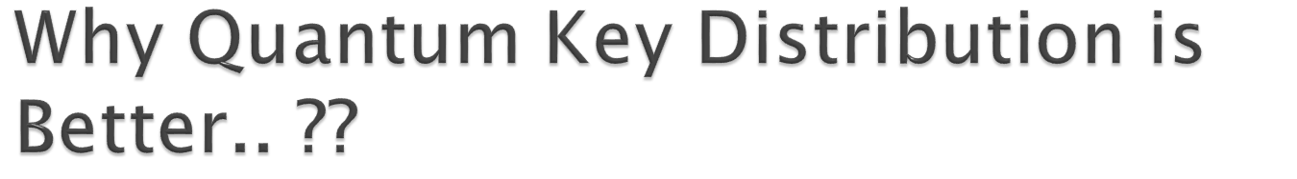
In classical cryptography, communicating parties need to share a secret sequence of random numbers, the key, that is exchanged by physical means and thus open to security loopholes.
In Quantum Cryptography,both parties are unaware of keys before sharing and the secret key is decided by matching of basis used at both ends which is completely random.
In quantum encryption two parties named Alice and Bob analyse pairs of entangled photons, which behave the same despite their separation, to create and share a unique key.
That key is used to securely encode and decode information.
Unlike classical cryptography, the key is truly random and therefore considered unbreakable.

Slide 5
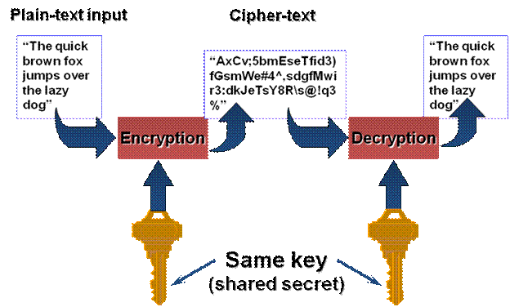

Slide 6

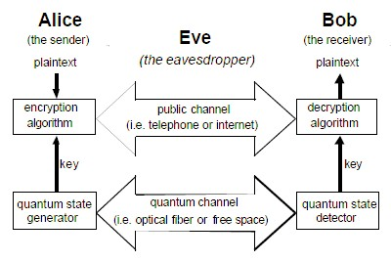

Slide 7

Alice and Bob first agree on two representations for ones and zeroes
One for each basis used, {,}
and {, }.
This agreement can be done in public
Define
1 =  0 = 
1 =  0 = 
Notes:
A schedule design for optional periods of time/objectives.

Slide 8
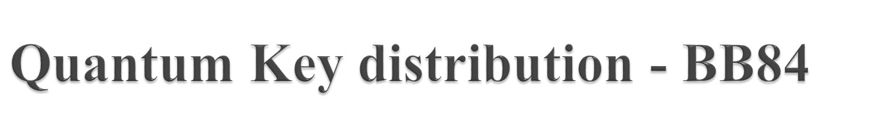
Alice sends a sequence of photons to Bob.
Each photon in a state with polarization corresponding to 1 or 0, but with randomly chosen basis.
Bob measures the state of the photons he receives, with each state measured with respect to randomly chosen basis.
Alice and Bob communicates via an open channel. For each photon, they reveal which basis was used for encoding and decoding respectively. All photons which has been encoded and decoded with the same basis are kept, while all those where the basis don't agree are discarded

Slide 9
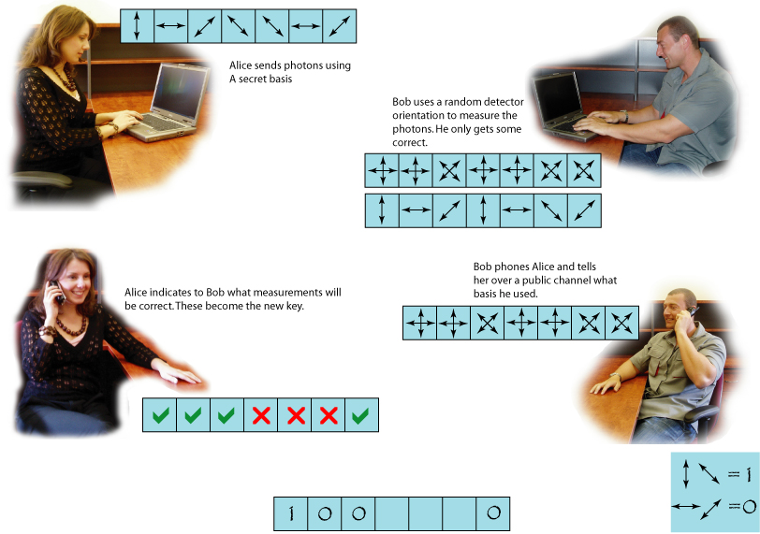

Slide 10
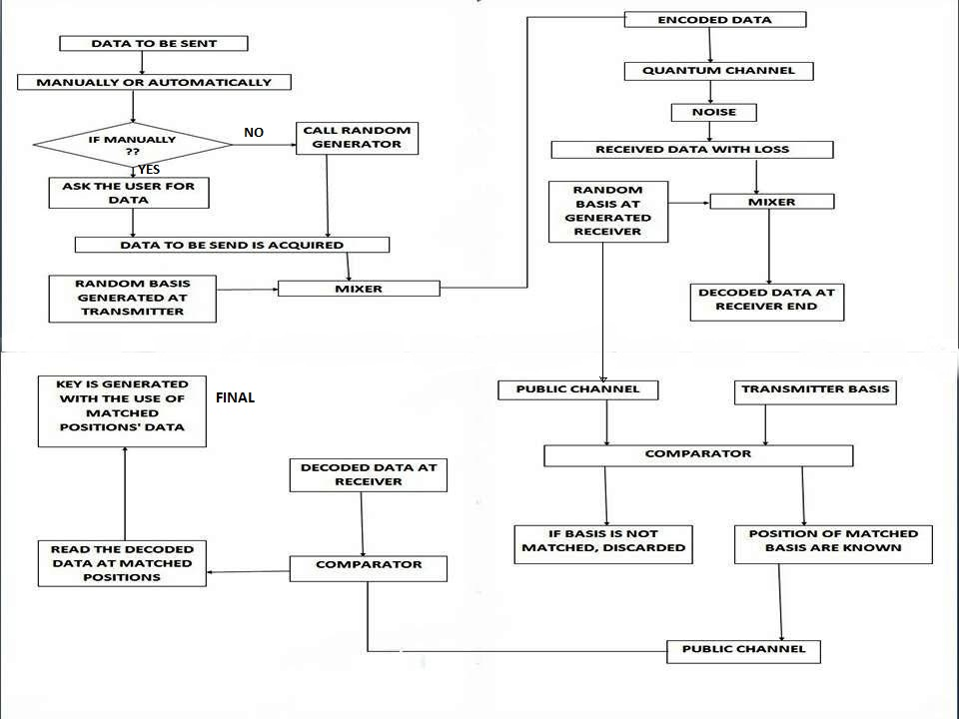
FLOW CHART OF ALGORITHM USED

Slide 11
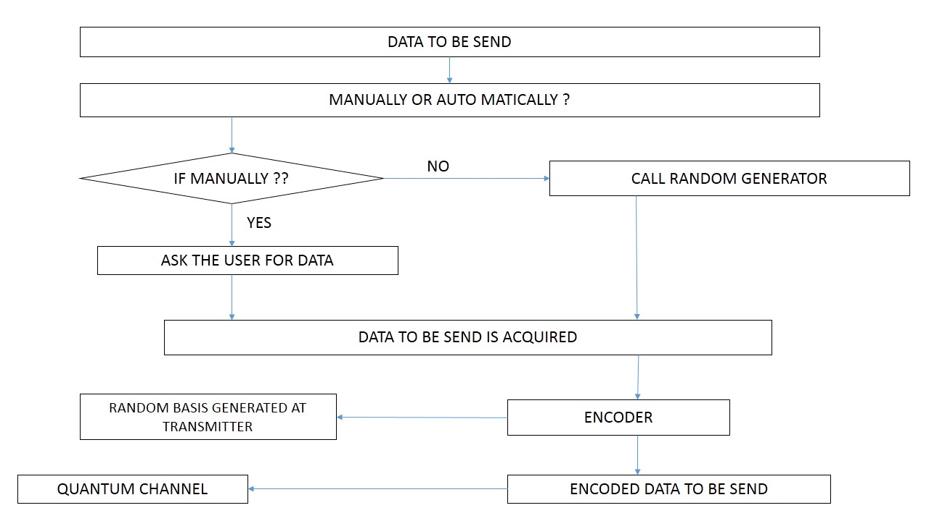
TRANSMITTER SECTION

Slide 12
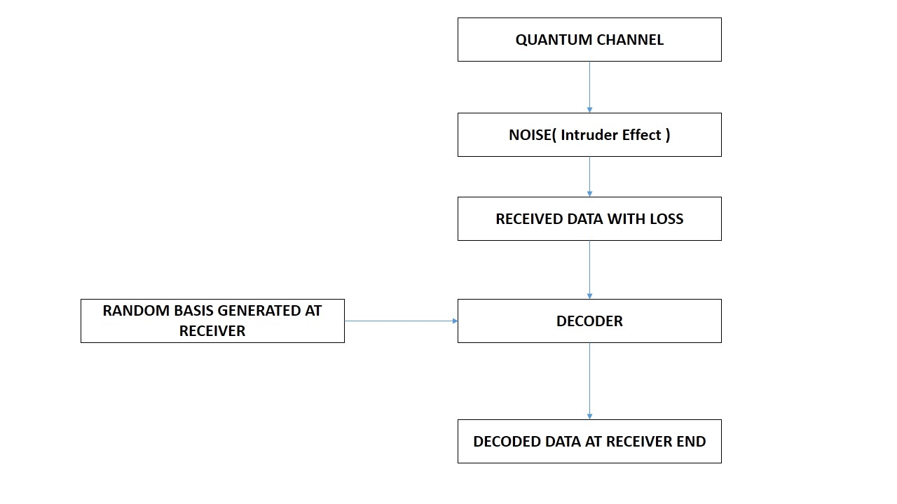
RECEIVER SECTION

Slide 13
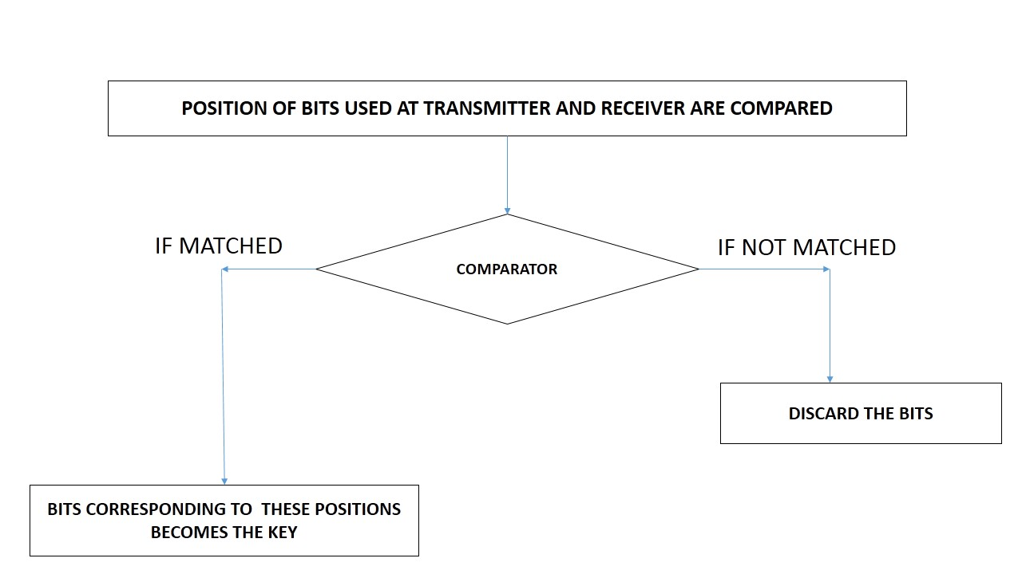
PUBLIC CHANNEL DISCUSSION

Slide 14

There are two scenarios to be considered with Evesdropping :
1. Data Loss Increases :
As Eve receives the photon, she destroys it and in the process, the data loss increases . To compensate this, she can try to duplicate the photons she receives.
This leads to scenario 2
2. Error Rate Increases :
Since, we cannot exactly replicate the photon we receive as per the No Cloning Theorem. So, Eve would be introducing lot of erroneous data in to the system which will increase the error rate.

Slide 15

The model with the influence of Evesdropper will be simulated and analysed.
Algorithm Chosen:
Now, if the probability of data loss is found to be greater than 0.5, then there are high chances that Evesdropper has tried to hamper the data, and in such case, the transmitted photons is discarded and retransmission of data photons is initiated.
The whole simulation is done keeping in mind the randomness of the data photons to transmit and the random data loss.

Slide 16
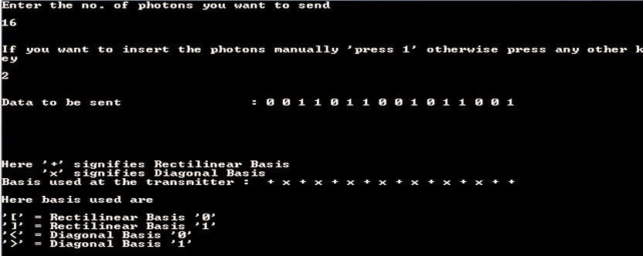
1. Here, the probability of data loss was found to be 80% which is more than 50% and hence, sender is asked to resend the data.

Slide 17
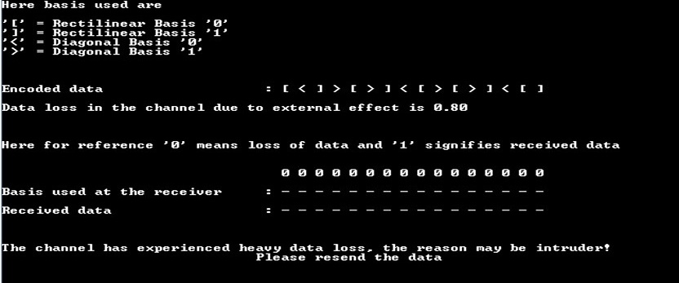

Slide 18
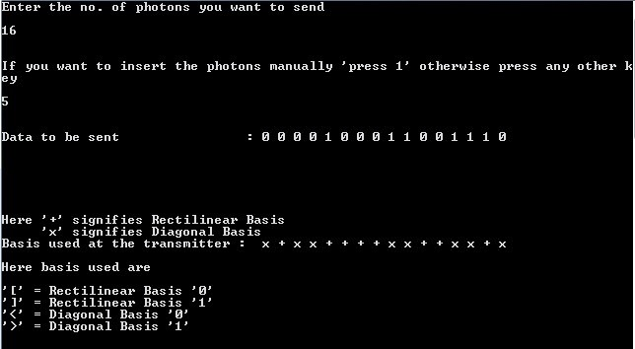
2. Here, the probability of data loss was found to be 10% which is acceptable and hence, the secret key is generated and shown.

Slide 19
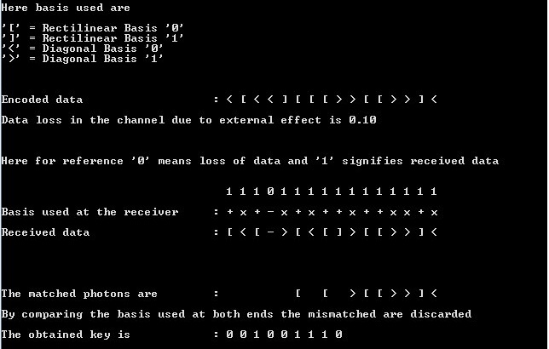

Slide 20

When Alice and Bob need to test for eavesdropping
Error rate < E_{max} ⇒ assume no eavesdropping
Error rate > E_{max} ⇒ assume eavesdropping
(or the channel is unexpectedly noisy)
Alice and Bob should then discard the whole key and start over

Slide 21

Each photon can only travel 100 kilometres through an optic fibre before it is absorbed.
Only the distance of transmission is the limiting factor in the Quantum Key Distribution.
Still, a lot many researches are going on in this direction to overcome this issue.
The system design is really very complex and expensive. As it is completely different from Classical Key Distribution, so, changes are really difficult to implement.
But the degree of security it offers, the changes are worth a try.

Slide 22
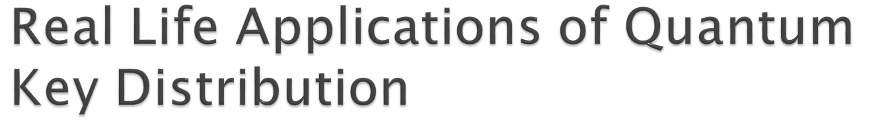
Since 2007, Switzerland has been using quantum cryptography to conduct secure online voting in federal and regional elections
Secure communications with satellites and astronauts is an increasing concern, and a company called QuintessenceLabs is working on a project for NASA to implement QKD.
In the future, however, it’s possible that we could switch seamlessly between “regular” and “quantum encrypted” internet, so that our most sensitive transmissions would be passed along in an ultra-secure manner.

Slide 23

The intricate details of error calculation and automatic tweaking of error threshold levels.
The performance of the protocol when subjected to Impersonation attacks.
Throughput calculation when channel is subjected to heavy traffic and separation distance is large.

Slide 24

Quantum cryptography is a major achievement in security engineering.
As it gets implemented, it will allow perfectly secure bank transactions, secret discussions for government officials, and well-guarded trade secrets for industry!

Slide 25
REFERENCES
[1] Timonthy P.Spiller, ”Quantum Information Processing: Cryptography, Computation, and Teleportation,” Proceedings of the IEEE, VOL. 84, NO.12, December 1996
[2] Marcin Niemiec and Andrzej R. Pach, Management of security in Quantum Cryptography,” IEEE Communications magazine, August 2013
[3] O.Sami Saydjari, “Quantum Cryptography,” IEEE Security & Privacy Journal, July/August 2004
[4] Bennett, Ch. H., & Brassard, G., ”Quantum cryptography: public key distribution and coin tossing”, IEEE Conference on Computer, Systems, and
Signal Processing, 1984, pp. 175-90.
[5] Coron, J. S., “ What is cryptography?”, IEEE Security & Privacy Journal, 12(8), 2006, p. 70-73.
[6] Elliot, C., “Quantum Cryptography”, IEEE Security & Privacy Journal, 2004, pp. 57-61.

Slide 26
THANK
YOU

